Slide 1
Evolution of Sex

Slide 2
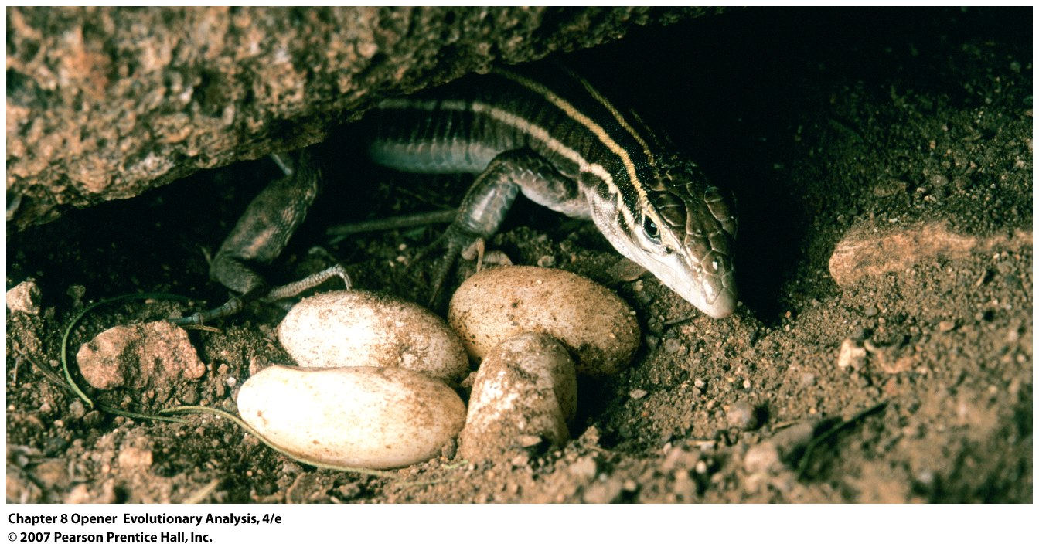
Evolution of Sex
Importance
Nearly universal biological phenomenon
What is its advantage?
Notes:
Chapter 8 Opener An asexual lizard
Female desert grasslands whiptails (Cnemidophorus uniparens) lay unfertilized eggs that hatch into clones of their mother. There are no males.
ADV of not having to find a male?????
Search time
STD’s
Disadv: ?????
Desert Grassland Whiptail Lizard
From Wikipedia, the free encyclopedia
Jump to: navigation, search
Desert Grassland Whiptail Lizard Scientific classification Kingdom: Animalia Phylum: Chordata Class: Reptilia Order: Squamata Suborder: Sauria Family: Teiidae Genus: Aspidoscelis Species: A. uniparens Binomial name Aspidoscelis uniparens (Wright & Lowe, 1965)
The Desert Grassland Whiptail lizard (Aspidoscelis uniparens) is an all-female species. It was formerly placed in the genus Cnemidophorus. These reptiles reproduce by parthenogenesis; eggs undergo a chromosome doubling after meiosis and develop into lizards without being fertilized. However, ovulation is enhanced by female-female courtship and "mating" (pseudocopulation) rituals that resemble the behavior of closely related to species that reproduce sexually.^{[1][2][3]} However, this claim has been disputed, as Collins and Pinch relate.^{[4]}
The lizard lives in dry deserts from central Arizona to west Texas and south into Mexico.
References
^ Crews, D. & Fitzgerald, K.T. (1980). "Sexual" behavior in parthenogenetic lizards (Cnemidophorus). Proceedings of the National Academy of Sciences, 77, 1. pp. 499-502.
^ Crews, D., Grassman, M. & Lindzey, J. (1986). Behavioral Facilitation of Reproduction in Sexual and Unisexual Whiptail Lizards. Proceedings of the National Academy of Sciences, 83, 24. pp. 9547-9550.
^ Grassman, M. & Crews, D. (1987). Dominance and reproduction in a parthenogenetic lizard. Behavioral Ecology and Sociobiology, 21. pp. 141-147.
^ Collins, H. M. & Pinch, T. J. (1993). The Golem: What You Should Know about Science. Cambridge, United Kingdom: Cambridge University Press, pp. 109-119.

Slide 3
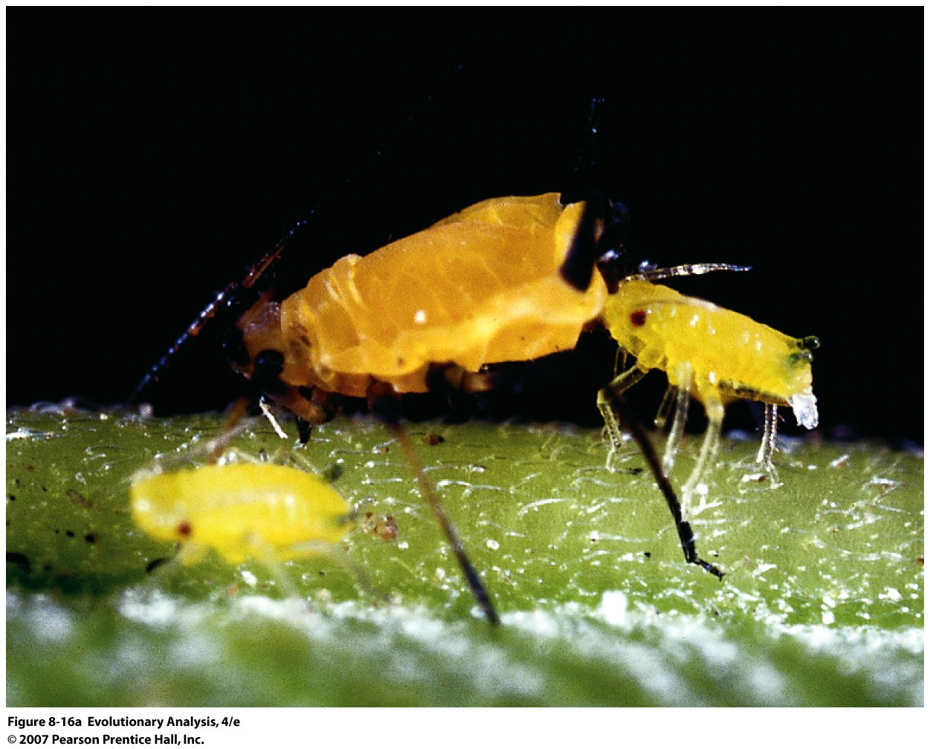
II. Back to Evolution of Sex- Frequency
Asexual reproduction in an aphid
Notes:
Figure 8.16a Organisms with two modes of reproduction, both mating systems exist in same population yet asexuality does not replace sex.
(a) Asexual reproduction in an aphid. The large aphid is giving birth to a daughter, produced by parthenogenesis, that is genetically identical to its mother. In the fall, the aphids will switch to sexual reproduction.

Slide 4
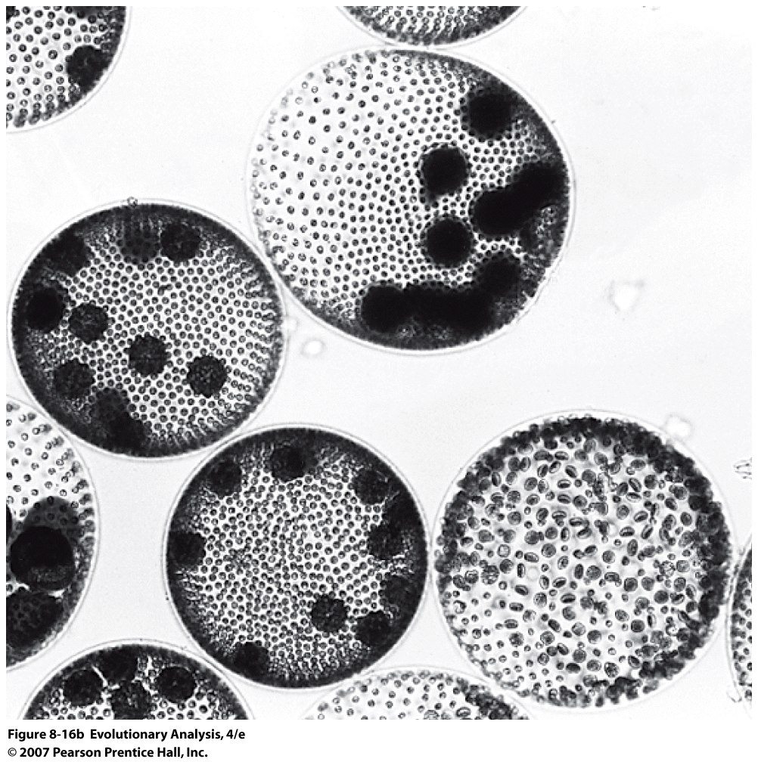
Volvox aureus, a freshwater alga
female
male
Asexual
Notes:
Figure 8.16b Organisms with two modes of reproduction
(b) Volvox aureus, a freshwater alga. Each large sphere is a single adult individual. Before maturity, any individual has the potential to develop as a sexual male, a sexual female, or an asexual. The (entirely visible) individual at lower right is a male. The randomly oriented disks are packets of sperm. The large individual above and to his left is a female. Each of the dark fuzzy spheres inside her is an encysted zygote. The individual directly to the left of the male is an asexual. Each of the dark spheres inside it is an offspring, developing by mitosis into a clone of the parent.

Slide 5
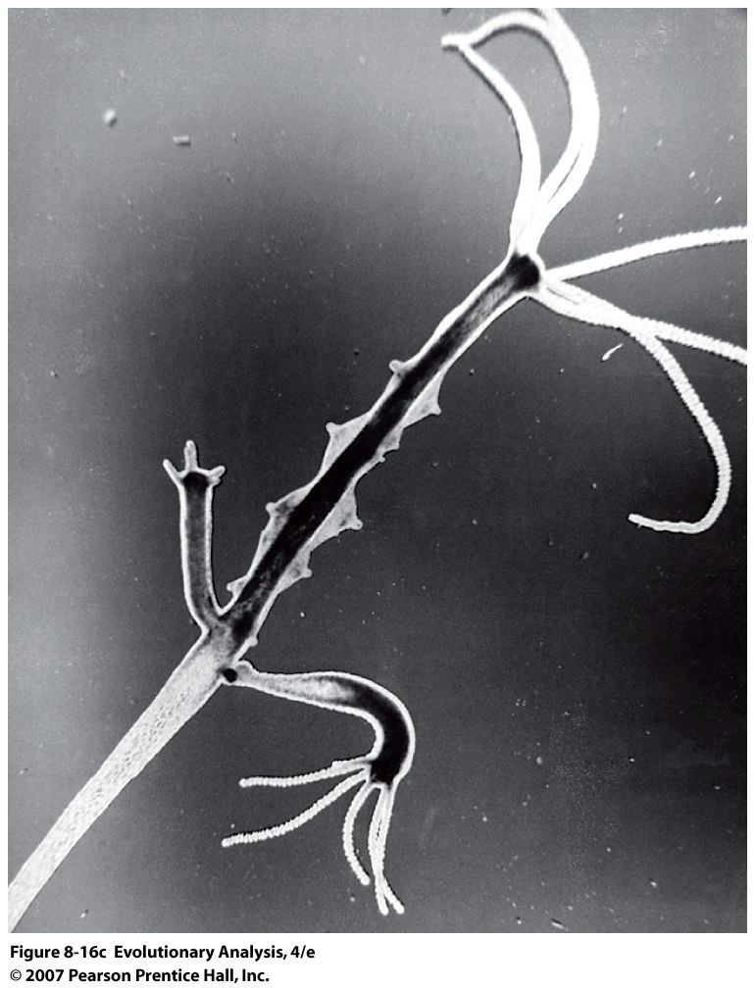
A hydra. This individual is reproducing both sexually and asexually.
The crown of tentacles at the upper left surround the hydra's mouth.
Along the body below the mouth are rows of testes. Below the testes are two asexual buds.
Asexual Reproduction also rarely
observed in fish and reptiles
Notes:
Figure 8.16c Organisms with two modes of reproduction
(c) A hydra. This individual is reproducing both sexually and asexually. The crown of tentacles at the upper left surround the hydra's mouth. Along the body below the mouth are rows of testes. Below the testes are two asexual buds.

Slide 6
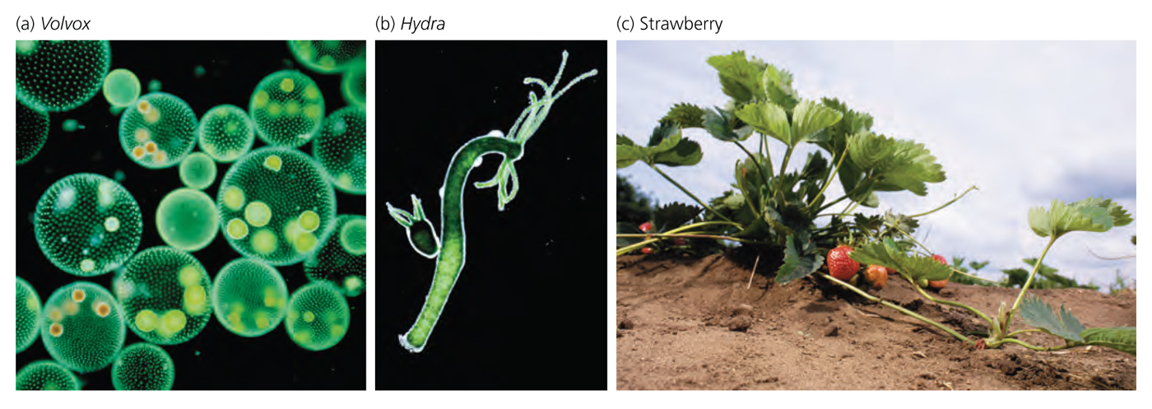
Notes:
Volvox, a freshwater alga, each large sphere is an adult, most are cloning through daughters, red spheres indicate fertilization by sperm
Hyrda, asexual budding at bottom and gonads at top
Strawberry reproduces sexually via fruits with seeds and asexually via runners.

Slide 7
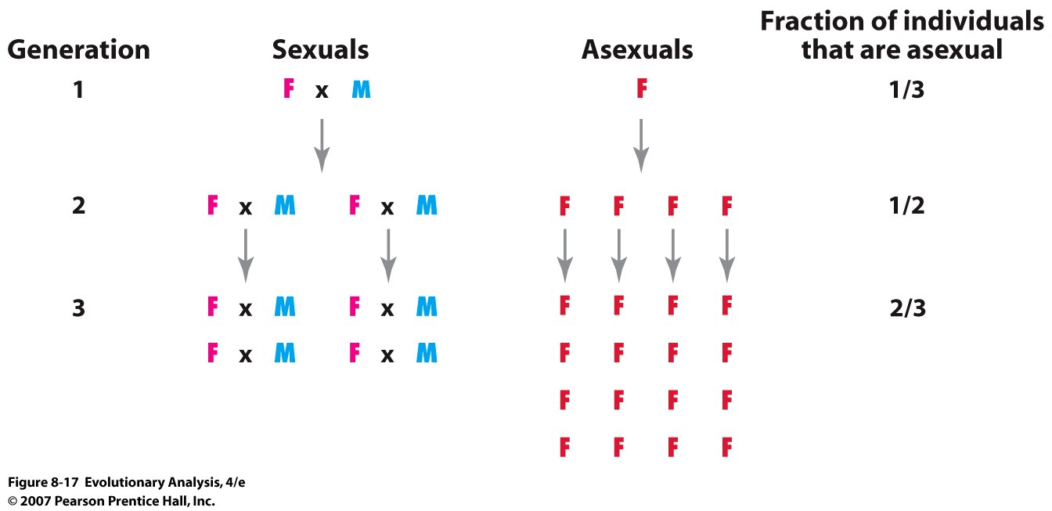
III. Evolutionary Advantage of Asexual Reproduction
Maynard Smith and the Adv. Of Sexual vs Asexual Reproduction
A female’s reproductive mode does not affect the number of her offspring
A female’s reproductive mode does not affect the probability of offspring survival
The reproductive advantage of asexual females: Two fold advantage
Two fold genetic transmission advantage
Notes:
Figure 8.17 The reproductive advantage of asexual females, population numbers depend on number of females.
Imagine a population founded by three individuals: a sexual female, a sexual male, and an asexual female. Every generation, each female produces four offspring, after which the parents die. All offspring survive to reproduce. Half of the offspring of sexual females are female; the other half are male. All of the offspring of asexual females are, of course, female. Under these simple assumptions, the fraction of individuals in the population that are asexual females increases every generation. After John Maynard Smith (1978). But parental care.
what sex controls population growth?

Slide 8
IV. Linkage Disequilibrium and Sex
First a quick diversion on linkage disequilibrium
Notes:
Figure 8.1 A pair of linked loci

Slide 9
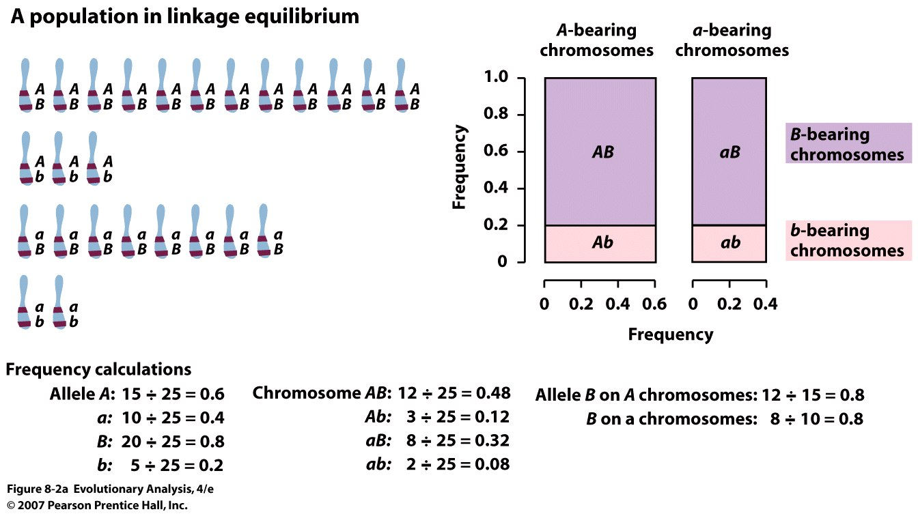
Expected frequency of AB = 0.6 x 0.8 = 0.48 and so forth
Notes:
Figure 8.2a Two populations: one in linkage equilibrium; one in linkage disequilibrium. Allele frequencies the same, but chromosome frequencies different

Slide 10
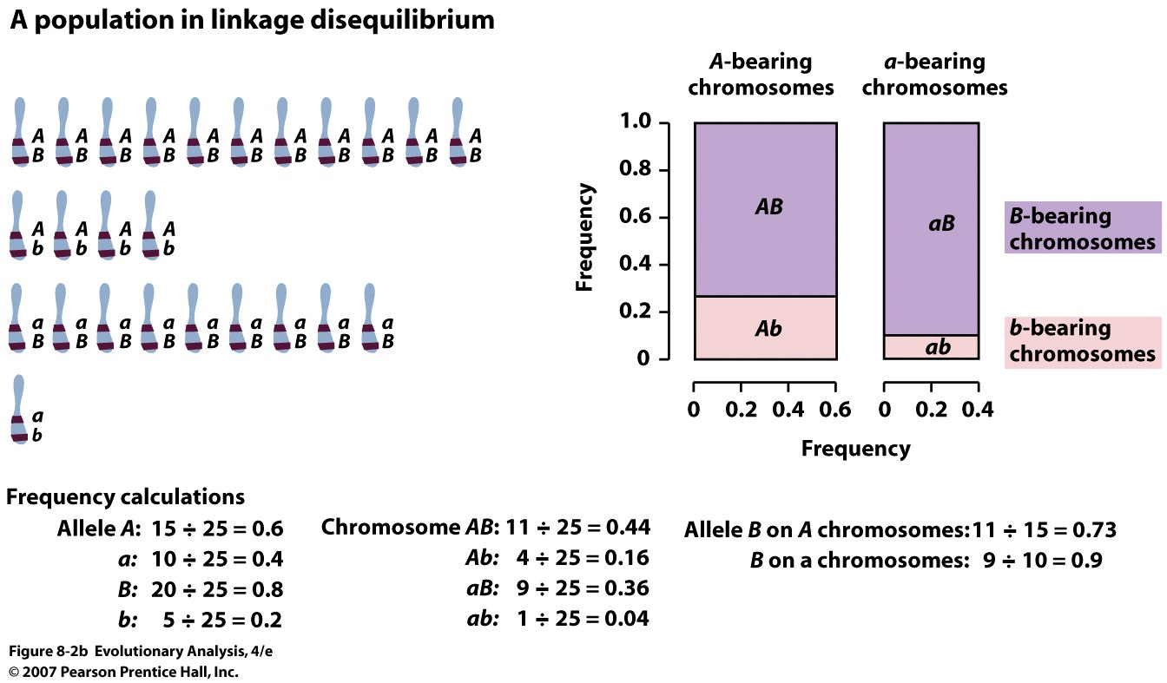
LD = or D = gABgab – gAbgaB; e.g. = 0.44x0.04 – 0.16x0.36
Notes:
Figure 8.2b Two populations: one in linkage equilibrium; one in linkage disequilibrium

Slide 11
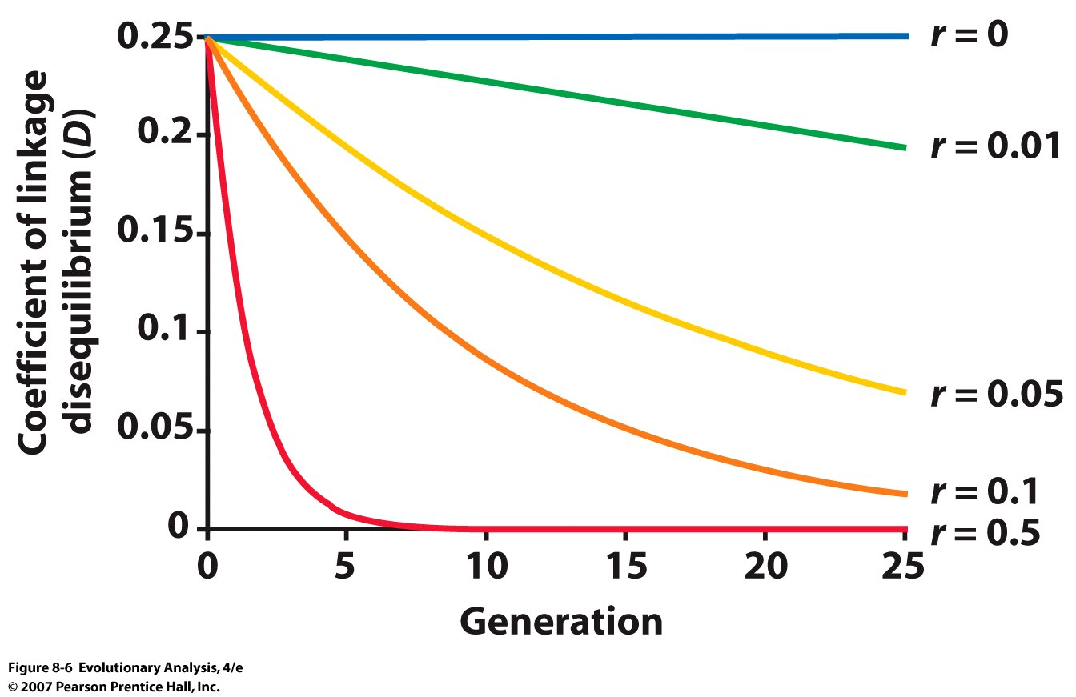
LD will decay over time by a factor of (1-r) in absence of selection
Notes:
Figure 8.6 With sexual reproduction and random mating, linkage disequilibrium falls over time
This graph shows the level of linkage disequilibrium between two loci over 25 generations in a random-mating population. The population starts with linkage disequilibrium at its maximum possible value, 0.25. Each curve shows the decline in linkage disequilibrium, according to the equation D' = D(1 - r), for a different value of r. With r = 0.5, which corresponds to the free recombination of loci on different chromosomes, the population reaches linkage equilibrium in less than 10 generations. With r = 0.01, which corresponds to closely linked loci, linkage disequilibrium persists for many generations. After Hedrick (1983).
Why is r maximum at 0.5

Slide 12
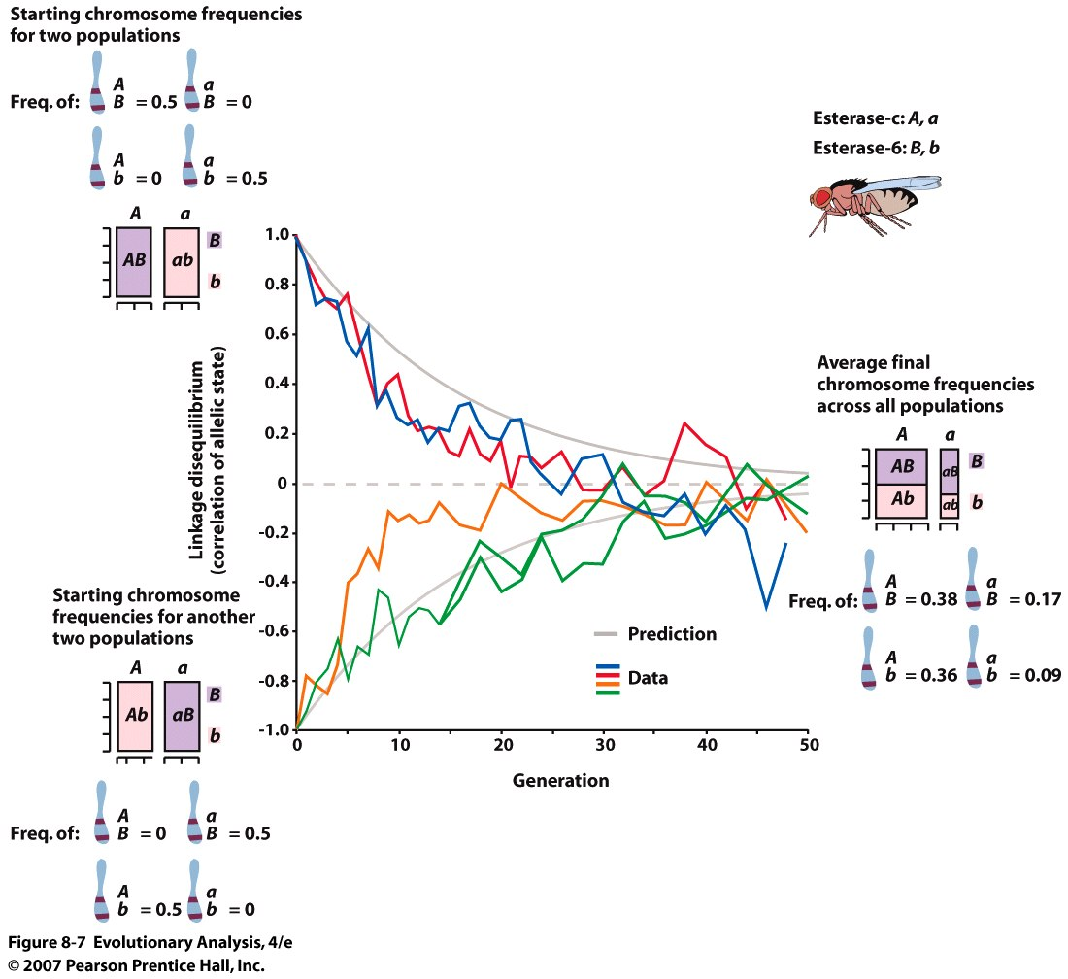
Notes:
Figure 8.7 An empirical demonstration that sexual reproduction reduces linkage disequilibrium
Each of several populations of fruit flies began in complete linkage disequilibrium (upper and lower bar graphs on the left). Over 50 generations, all populations approached linkage equilibrium (bar graph on the right). Redrawn from Clegg et al. (1980), with frequencies in the bar graph on the right inferred from data therein. Heterozygote superiourity caused LD to decline quicker

Slide 13
What is the origin of linkage disequilibrium??
1. Natural Selection (selection on 2 loci, hitchhiking)
Mimulus inversions
Selection on lactose tolerance and nearby neutral
alleles dragged along for the ride
2. Drift (bottlenecks and appearance of a mutation)
Diseases and neutral alleles: Tay-Sachs, Gaucher’s
3. Population Mixture (hybrid zones)
AABB population mixes with aabb population, after
only 1 generation of mating: AABB, AaBb, aabb
Notes:
Use blackboard

Slide 14
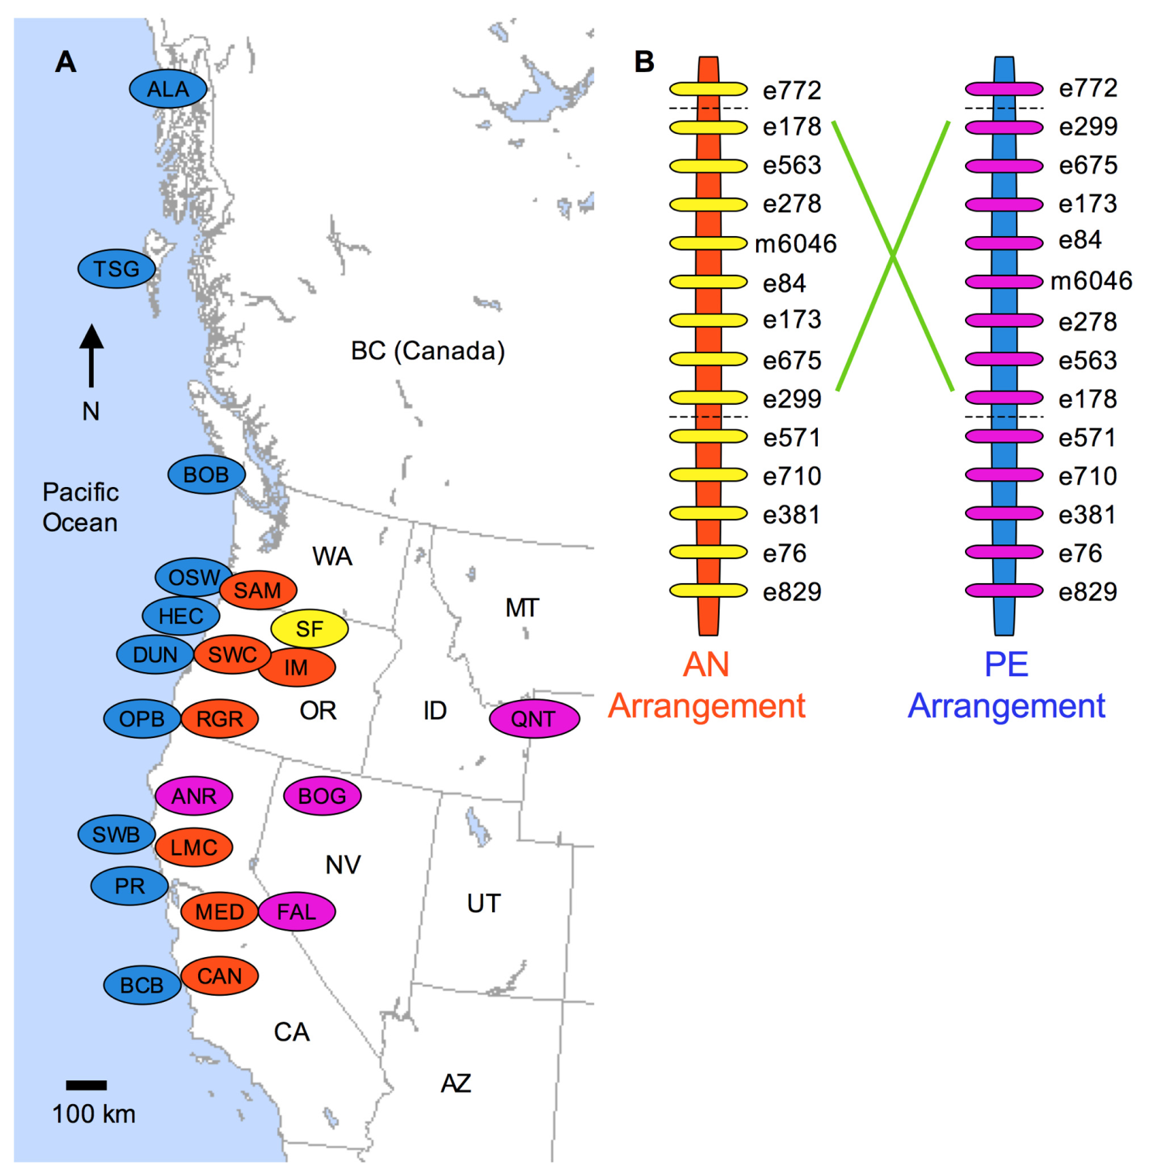
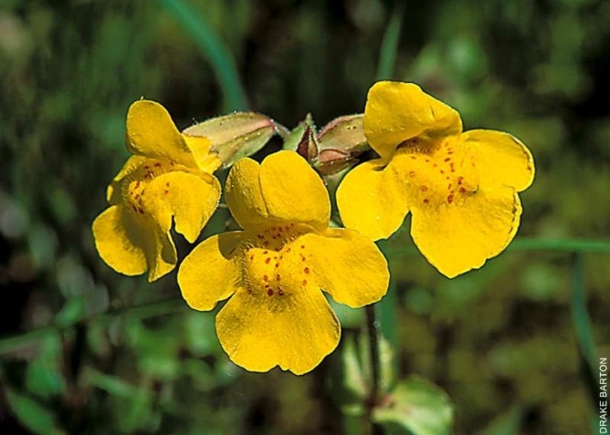
Mimulus guttatus
Figure 1. Geographic distribution of the chromosomal inversion. (A) Map of western North America with the locations of populations ofcoastal perennials (blue), inland annuals (orange), and inland perennials (purple), as well as obligate self-fertilizing species M. nasutus (yellow). (B) Marker order of the AN and PE inversion arrangements along linkage group eight. Inland annuals and M. nasutus had the AN arrangement whilecoastal and inland perennials all had the PE arrangement.
doi:10.1371/journal.pbio.1000500.g001
Adaptive Inversion Contributes to Isolation
PLoS Biology | www.plosbiology.org 3 September 2010 | Volume 8 | Issue 9 | e1000500

Slide 15
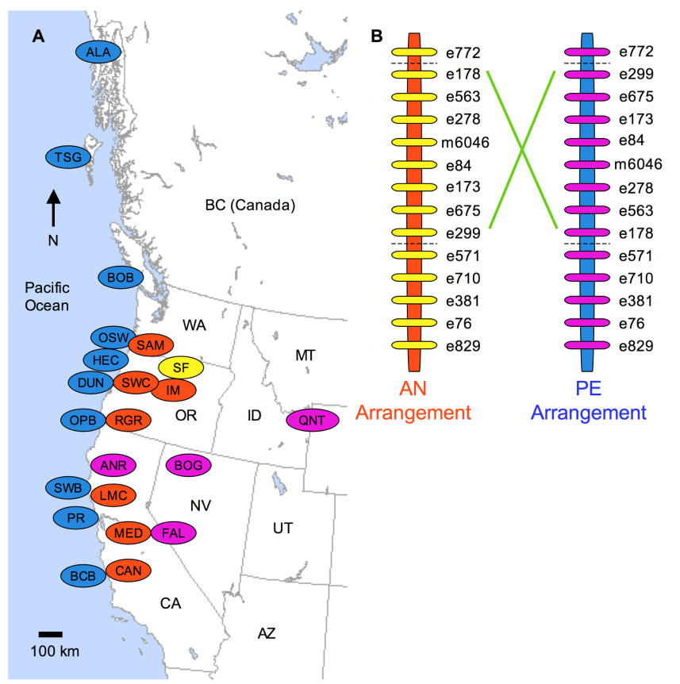
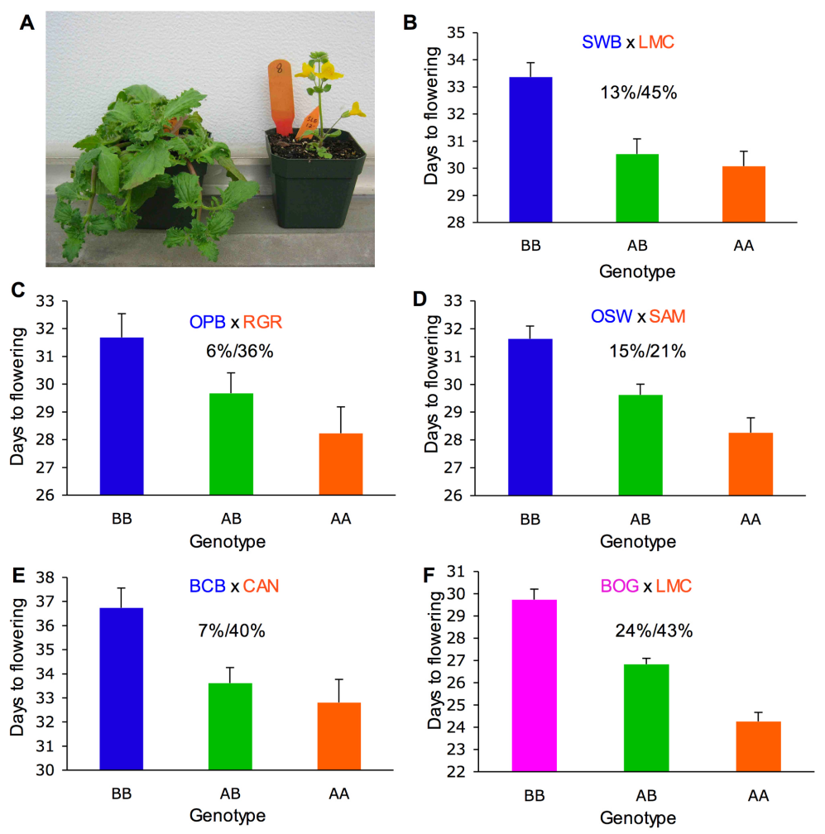
Figure 2. Replicated effect of the inversion locus. (A) F2 progeny with parental ecotypic phenotypes, from a cross between the SWB (coastal
perennial) and LMC (inland annual) populations. (B–E) Effect of the inversion on flowering time in four independently derived F2 mapping
populations created through crosses between independent inland annual and coastal perennial populations. (F) Effects of the inversion on flowering
time in cross between inland annual and inland perennial populations. The mean flowering times (61 SE) of F2s that were homozygous for the AN
arrangement (AA), heterozygous (AB), and homozygous for the PE arrangement (BB) at Micro6046 are indicated. The percentage of F2 variance/
parental divergence explained by the inversion is presented above each bar graph. Note: y-axes do not originate at zero.
doi:10.1371/journal.pbio.1000500.g002

Slide 16
III. Evolutionary Advantage of Asexual Reproduction
Maynard Smith and the Adv. Of Sexual vs Asexual Reproduction
A female’s reproductive mode does not affect the number of her offspring
A female’s reproductive mode does not affect the probability of offspring survival
The reproductive advantage of asexual females: Two fold advantage
Two fold genetic transmission advantage
Notes:
Figure 8.17 The reproductive advantage of asexual females, population numbers depend on number of females.
Imagine a population founded by three individuals: a sexual female, a sexual male, and an asexual female. Every generation, each female produces four offspring, after which the parents die. All offspring survive to reproduce. Half of the offspring of sexual females are female; the other half are male. All of the offspring of asexual females are, of course, female. Under these simple assumptions, the fraction of individuals in the population that are asexual females increases every generation. After John Maynard Smith (1978). But parental care.

Slide 17
Sex: Linkage Disequilibrium & Selection
Recombination (sex) brings favorable alleles together faster than mutation
Recombination (sex) allows chromatids to loose disadvantageous alleles
Notes:
Use blackboard

Slide 18
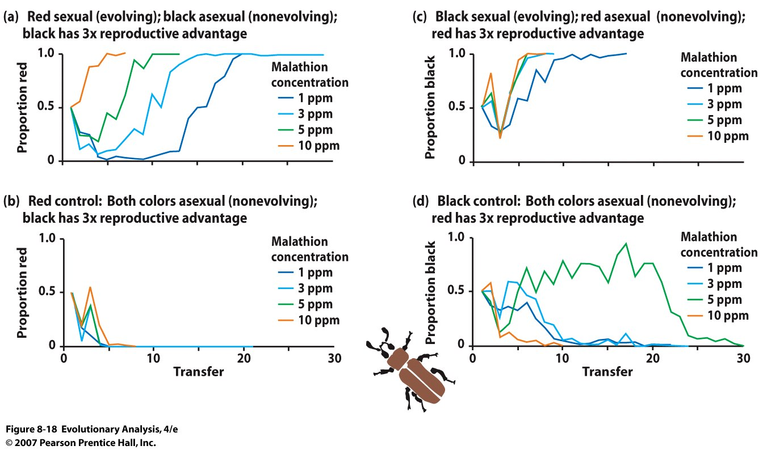
V. Advantages of Sex: Beneficial alleles
Notes:
Figure 8.18 An experimental test of assumption 2 of Maynard Smith's null model Reservoir population
Each panel shows the relative frequency, in a mixed population, of the flour beetle strain that has been placed at a reproductive disadvantage but [in (a) and (c)] reproduces sexually and evolves. The four time-series in each panel represent cultures treated with different concentrations of malathion (ppm = parts per million). A transfer is analogous to a generation. (a) Red is at a reproductive disadvantage, but has sexual reproduction and evolves. Red eventually eliminates black. (b) Red is at a reproductive disadvantage and does not evolve. Red is quickly eliminated by black. (c) Black is at a reproductive disadvantage, but has sexual reproduction and evolves. Black quickly eliminates red. (d) Black is at a reproductive disadvantage and does not evolve. Black is eventually eliminated by red. Redrawn from Dunbrack et al. (1995).

Slide 19
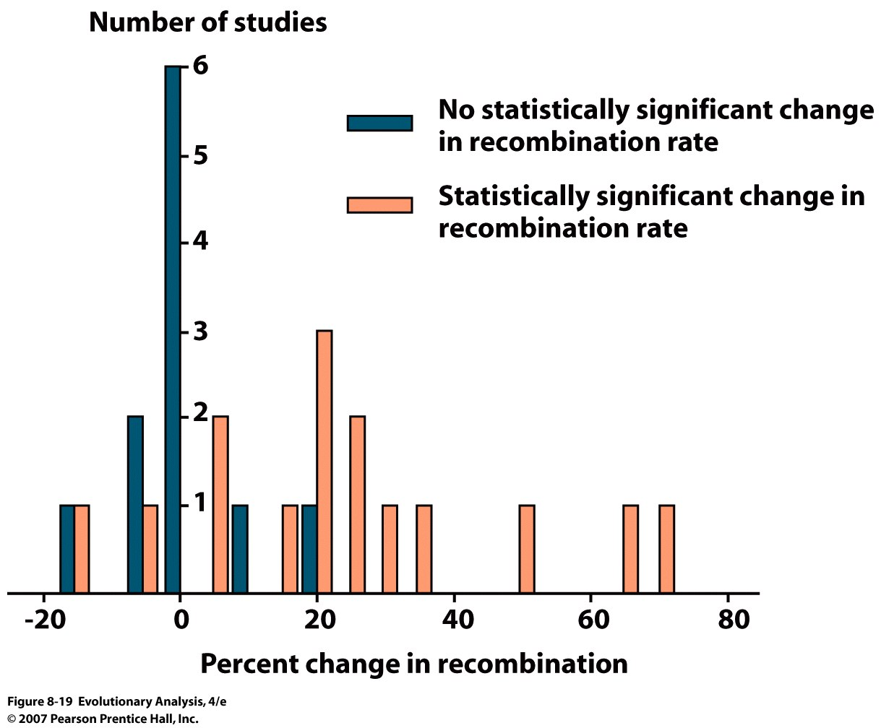
Recombination contributes to adaptation
Notes:
Figure 8.19 Artificial selection favors increased genetic recombination 13/15 increase in recomination
This graph summarizes the results of experiments in which researchers artificially selected for traits unrelated to sex and recombination rate, then assessed changes in rate of recombination during meiosis. Among the experiments in which selection produced a significant change in recombination rate (brown bars), the majority of the changes were increases. Rerendered from Otto and Lenormond (2002).

Slide 20
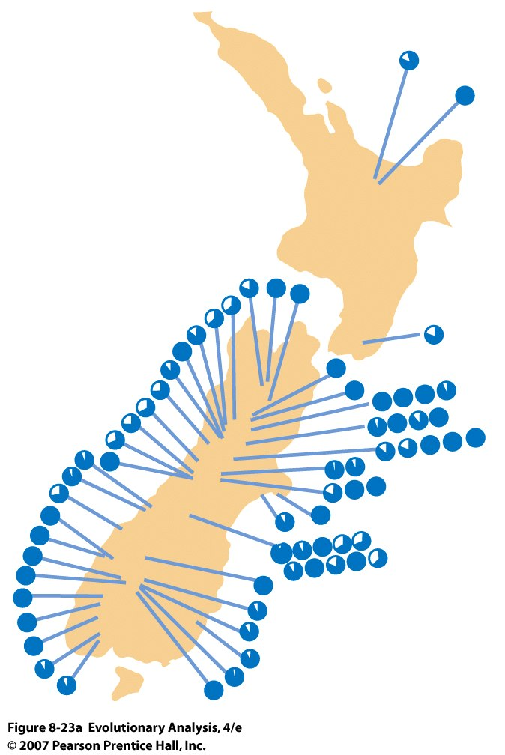
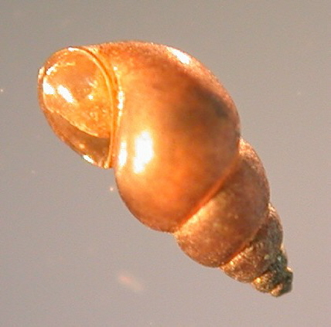
Selection
Snails and trematode parasites
Red Queen Hypothesis
(Leigh van Valen)
Segregation & Recombination
recreate rare, favored
genotypes
New Zealand
Mud Snail
2 types of
females:
Sexual
Asexual
White = frequency of males
Notes:
Figure 8.23a The frequency of sexual individuals in populations of a host snail is positively correlated with the frequency of its trematode parasites
(a) The map shows the locations of the 66 lakes Lively sampled. In each population's pie diagram, the white slice represents the frequency of males.

Slide 21
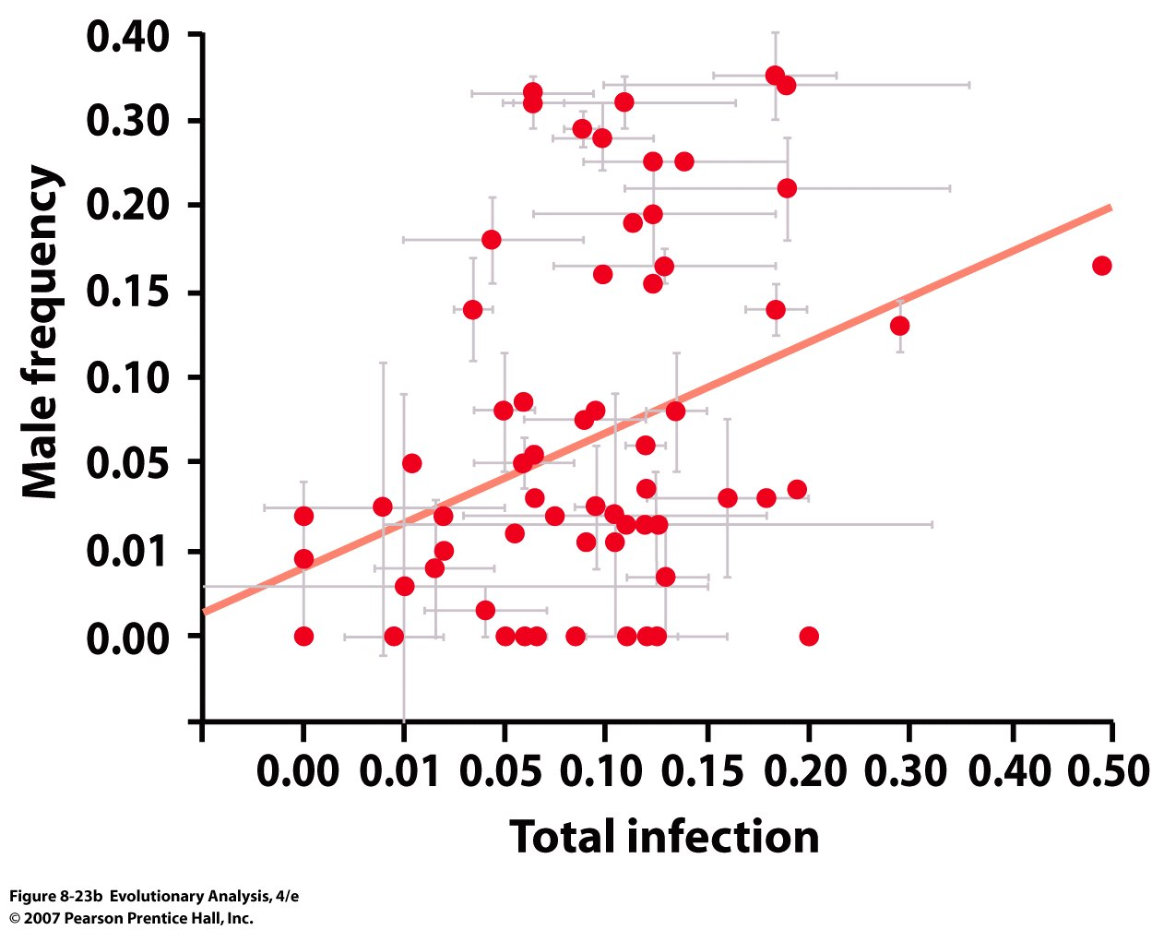
Notes:
Castration of gonads
Figure 8.23b The frequency of sexual individuals in populations of a host snail is positively correlated with the frequency of its trematode parasites
(b) The scatterplot shows the frequency of males in each population versus the proportion of snails infected with trematodes. The graph includes a best-fit line. Males are more frequent in populations in which more snails are infected. From Lively (1992).
New Zealand mud snail
From Wikipedia, the free encyclopedia
Jump to: navigation, search
This article is about the invasive mudsnail Potamopyrgus antipodarum. For another mud snail from New Zealand, see Amphibola crenata.
New Zealand mudsnail Lateral view of a Potamopyrgus antipodarum shell Conservation status NE
Scientific classification Kingdom: Animalia Phylum: Mollusca Class: Gastropoda (unranked): clade Caenogastropoda clade Hypsogastropoda clade Littorinimorpha
Superfamily: Rissooidea Family: Hydrobiidae Genus: Potamopyrgus Species: P. antipodarum Binomial name Potamopyrgus antipodarum J. E. Gray, 1843^{[1]} Synonyms Amnicola antipodanum J. E. Gray, 1843
Potamopyrgus jenkinsi (E. A. Smith, 1889)
The New Zealand mudsnail, Potamopyrgus antipodarum, sometimes previously known as Potamopyrgus jenkinsi, is a species of very small or minute freshwater snail with a gill and an operculum, an aquatic gastropod mollusk in the family Hydrobiidae.
This is an invasive species in many countries, where populations of this snail can reach phenomenal densities.
Contents
1 Forms
2 Shell description
3 Original description
4 Distribution
4.1 Nonindigenous distribution
4.2 Invasion in Europe
4.3 Distribution within the USA
5 Ecology
5.1 Habitat
5.2 Feeding habits
5.3 Life cycle
5.4 Parasites
5.5 Other interspecific relationship
6 References
7 Further reading
8 External links
Forms
Potamopyrgus antipodarum f. carinata (J. T. Marshall, 1889)
Shell description
Shells of Potamopyrgus antipodarum f. carinata (left) and Potamopyrgus antipodarum (right). Scale bar is 0.5 cm.
A group of mud snails of all growth sizes from juvenile to adults, compared to an American 10 cent coin which is 18 mm in diameter.
The shell of Potamopyrgus antipodarum is elongated and it has dextral coiling. The shell has 7 or 8 whorls. Between whorls are deep grooves.
This is an operculate snail, meaning it has a 'lid' that can seal the opening of its shell. The operculum is thin and corneus with an off-centre nucleus from which paucispiral markings (with few coils) radiate. The aperture is oval and its height is less than the height of the spire.
Some morphs, including many from the Great Lakes, exhibit a keel in the middle of each whorl; others, excluding those from the Great Lakes, exhibit periostracal ornamentation such as spines for anti–predator defense.^{[2][3][4][5]}
Shell colors vary from gray and dark brown to light brown.
The average height of the shell is approximately 5 mm ( in); maximum size is approximately 12 mm ( in). The snail is usually 4–6 mm in length in the Great Lakes, but grows to 12 mm in its native range.^{[2][4][5]}
Original description
This species was originally described as Amnicola antipodarum in 1843 by John Edward Gray:
"Inhabits New Zealand, in fresh water. Shell ovate, acute, subperforated (generally covered with a brown earthy coat); whorls rather rounded, mouth ovate, axis 3 lines; operculum horny and subspiral: variety, spire rather longer, whorls more rounded. This species is like Paludina nigra of Quoy and Gaimard, but the operculum is more spiral. Quoy described the operculum as concentric, but figured it subspiral. Paludina ventricosa of Quoy is evidently a Nematura."^{[1]}
Distribution
This species is endemic to New Zealand. It lives in freshwater streams and lakes in New Zealand and adjacent small islands.^{[6]}
Nonindigenous distribution
While endemic to New Zealand, the New Zealand mud snail has spread widely and has become naturalised and an invasive species in many areas including: Australia, Tasmania, Asia (Japan,^{[7]} in Garmat Ali River in Iraq since 2008^{[8]}), Europe (since 1859 in England), and North America (USA and Canada: Thunder Bay in Ontario since 2001, British Columbia since July 2007^{[7]}), most likely due to inadvertent human intervention.
Invasion in Europe
England since 1859^{[9]} - probably the first introduction in Europe
Germany
Poland
Western Baltic Sea since 1887^{[10]}
Russia
Azov Black Sea region, since 1951,^{[11]} Ukraine since 1951 in brackish waters, and since 2005 in freshwater^{[12]}
Catalonia in Spain, since 1952^{[13]}
Mediterranean region of France, since the end of 1950s^{[13]}
Italy, since 1961^{[13]}
Turkey^{[13]}
Czech Republic, since September 3, 1981^{[14]}
Slovakia, since 1986^{[9]}
Greece, since November 2007^{[13]}
and other areas
Potamopyrgus antipodarum occurs in nearly the whole of Europe. It does not occur in Iceland, Albania, Bulgaria and the former Yugoslavia.^{[11]}
Distribution within the USA
Distribution of Potamopyrgus antipodarum within the USA in 2009.
First detected in the United States in Idaho's Snake River in 1987, the mud snail has since spread to the Madison River, Firehole River, and other watercourses around Yellowstone National Park; samples have been discovered throughout the Western United States.^{[15]} Although the exact means of transmission is unknown, it is likely that it was introduced in water transferred with live game fish and has been spread by ship ballast or contaminated recreational equipment such as wading gear.^{[16]}
The New Zealand mud snail has no natural predators or parasites in the United States, and consequently has become an invasive species. It can reach concentrations above 500,000 per m², endangering the food chain by outcompeting native snails and water insects for food, leading to sharp declines in the native populations.^{[17]} Fish populations then suffer because the native snails and insects are their main food source.
The mud snails are impressively resilient. A snail can live for 24 hours without water. They can however survive for up to 50 days on a damp surface,^{[18]} giving them ample time to be transferred from one body of water to another on fishing gear. The snails may even survive passing through the digestive system of a fish.
Mud snails have now spread from Idaho to most western states of the U.S., including Wyoming, California, Oregon, and Montana. Environmental officials for these states have attempted to slow the spread of the snail by advising the public to keep an eye out for the snails, and bleach or heat any gear which may contain the mud snails. Rivers have also been temporarily closed to fishing to avoid anglers spreading the snails.^{[19]}
The snails grow to a smaller size in the U.S. than in their native habitat, reaching 6 mm (¼ in) at most in parts of Idaho, but can be much smaller making them easy to overlook when cleaning fishing gear.
Clonal species like the New Zealand mud snail can often develop clonal lines with quite diverse appearances, called morphs. Until 2005, all the snails found in the western states of the U.S. were believed to be from a single line. However a second morph has been identified in Idaho's Snake River. It grows to a similar size but has a distinctive appearance. (It has been nicknamed the salt-and-pepper mud snail due to the final whorl being lighter than the rest of the shell.) This morph has apparently been present in the area for several years before being identified correctly as a distinct morph of Potamopyrgus antipodarum. It dominates the typical morph where they overlap, and has a much higher prevalence of males.^{[20]}
In 1991 the New Zealand mud snail was discovered in Lake Ontario,^{[21]} and has now been found in four of the five Great Lakes. In 2005 and 2006, it was found to be widespread in Lake Erie.^{[22]} By 2006 it had spread to Duluth-Superior Harbour and the freshwater estuary of the Saint Louis River.^{[23]} It was found to be inhabiting Lake Michigan, after scientists took water samples in early summer of 2008.^{[24]} The snails in the Great Lakes represent a different line from those found in western states, and were probably introduced indirectly through Europe.^{[20]}
As of 26 November 2009 Olympia Washington's Capital Lake is infested with the New Zealand Mud Snail. All three Boat Launches at the lake have been temporarily closed to pleasure boat traffic by the State's Department of General Administration.^{[25]}
In 2010, the Los Angeles Times reported that the New Zealand mud snail had infested watersheds in the Santa Monica Mountains, posing serious threats to native species and complicating efforts to improve stream-water quality for the endangered steelhead trout. According to the article, the snails have expanded "from the first confirmed sample in Medea Creek in Agoura Hills to nearly 30 other stream sites in four years." Researchers at the Santa Monica Bay Restoration Commission believe that the snails' expansion may have been expedited after the mollusks traveled from stream to stream on the gear of contractors and volunteers.^{[26]}
As of 21 September 2010 In Colorado, Boulder Creek and Dry Creek have infestations of New Zealand Mud Snails. The snails have been present in Boulder Creek since 2004 and were discovered in Dry Creek in Sept. 2010. Access to both creeks has been closed to help avoid spread of the snails.
Ecology
Habitat
The snail tolerates siltation, thrives in disturbed watersheds, and benefits from high nutrient flows allowing for filamentous green algae growth. It occurs amongst macrophytes and prefers littoral zones in lakes or slow streams with silt and organic matter substrates, but tolerates high flow environments where it can burrow into the sediment.[2][5][27][28][29][30][31][32][33][34][35]
In the Great Lakes, the snail reaches densities as high as 5,600 m² and is found at depths of 4–45 m on a silt and sand substrate.^{[2][4][5]}
This species is euryhaline, establishing populations in fresh and brackish water. The optimal salinity is probably near or below 5 ppt, but Potamopyrgus antipodarum is capable of feeding, growing, and reproducing at salinities of 0–15 ppt and can tolerate 30–35 ppt for short periods of time.^{[2][5][36][37][38][39]}
It tolerates temperatures of 0–34°C.^{[2][5][40]}
Feeding habits
Potamopyrgus antipodarum is a nocturnal grazer, feeding on plant and animal detritus, epiphytic and periphytic algae, sediments and diatoms.^{[2][5][41][42][43][44]}
Life cycle
Potamopyrgus antipodarum is ovoviviparous and parthenogenic. This means that they can reproduce asexually; females "are born with developing embryos in their reproductive system."^{[5][15]}
Native populations in New Zealand consist of diploid sexual and triploid parthenogenically cloned females, as well as sexually functional males (less than 5% of the total population). All introduced populations in North America are clonal, consisting of genetically identical females.^{[5]}
Each female can produce between 20 and 120 embryos.^{[16]} The snail produces approximately 230 young per year. Reproduction occurs in spring and summer, and the life cycle is annual.^{[2][5][6][39][45][46]}
The rapid reproduction rate of the snail has caused the numbers of individuals to increase rapidly in new environments. The highest concentration of New Zealand mud snails ever reported was in Lake Zurich, Switzerland, where the species colonized the entire lake within seven years to a density of 800,000 per m².^{[5][47]}
Parasites
In their native habitat, the snails pose no problem because of a trematode parasite which sterilizes many snails, keeping the populations to a manageable size. However they have become an invasive pest species elsewhere in the world in the absence of these parasites.^{[5]}
The parasites of this species include at least 11 species of Trematoda.^{[5][48]}
Common parasites of this snail include trematodes of the genus Microphallus.^{[5][49][50]}
Other interspecific relationship
Potamopyrgus antipodarum can survive passage through the guts of fish and birds and may be transported by these animals.^{[51]}
It can also float by itself or on mats of Cladophora spp., and move 60 m upstream in 3 months through positive rheotactic behavior.^{[2]} It can respond to chemical stimuli in the water, including the odor of predatory fish, which causes it to migrate to the undersides of rocks to avoid predation.^{[5][52]}
References
This article incorporates public domain text (a public domain work of the United States Government) from the reference.^{[5]}
^ ª ^{b} Dieffenbach, E. 1843. Travels in New Zealand; with contributions to the geography, geology, botany, and natural history of that country. In two volumes - Vol. II. - pp. i-iv [= 1-4], 1-396, pl. [1]. London. (Murray), page 241.
^ ª ^{b} ^{c} ^{d} ^{e} ^{f} ^{g} ^{h} ^{i} Zaranko, D. T., D. G. Farara and F. G. Thompson. 1997. Another exotic mollusk in the Laurentian Great Lakes: the New Zealand native Potamopyrgus antipodarum (Gray 1843) (Gastropoda, Hydrobiidae).
^ Holomuzki, J. R. and B. J. F. Biggs. 2006. Habitat–specific variation and performance trade–offs in shell armature of New Zealand mudsnails. Ecology 87(4):1038–1047.
^ ª ^{b} ^{c} Levri, E.P., A.A. Kelly and E. Love. 2007. The invasive New Zealand mud snail (Potamopyrgus antipodarum) in Lake Erie. Journal of Great Lakes Research 33: 1–6.
^ ª ^{b} ^{c} ^{d} ^{e} ^{f} ^{g} ^{h} ^{i} ^{j} ^{k} ^{l} ^{m} ^{n} º ^{p} Benson, A. J. and R. M. Kipp. 2008. Potamopyrgus antipodarum. USGS Nonindigenous Aquatic Species Database, Gainesville, FL. <http://nas.er.usgs.gov/queries/FactSheet.asp?speciesID=1008> Revision Date: 1/22/2008
^ ª ^{b} Hall, R. O. Jr., J. L. Tank and M. F. Dybdahl. 2003. Exotic snails dominate nitrogen and carbon cycling in a highly productive stream. Frontiers in Ecology and the Environment 1(8):407–411.
^ ª ^{b} Timothy M. Davidson, Valance E. F. Brenneis, Catherine de Rivera, Robyn Draheim & Graham E. Gillespie. Northern range expansion and coastal occurrences of the New Zealand mud snail Potamopyrgus antipodarum (Gray, 1843) in the northeast Pacific Aquatic Invasions (2008) Volume 3, Issue 3: 349-353.
^ Murtada D. Naser & Mikhail O. Son. 2009. First record of the New Zealand mud snail Potamopyrgus antipodarum (Gray 1843) from Iraq: the start of expansion to Western Asia?. Aquatic Invasions, Volume 4, Issue 2: 369-372, DOI 10.3391/ai.2009.4.2.11.
^ ª ^{b} Čejka T., Dvořák L. & Košel V. 2008: Present distribution of Potamopyrgus antipodarum (Gray, 1843) (Mollusca: Gastropoda) in the Slovak Republic. - Malacologica Bohemoslovaca, 7: 21-25. Online serial at <http://mollusca.sav.sk> 25-February-2008.
^ Dmitry P. Filippenko & Mikhail O. Son. The New Zealand mud snail Potamopyrgus antipodarum (Gray, 1843) is colonising the artificial lakes of Kaliningrad City, Russia (Baltic Sea Coast). Aquatic Invasions (2008) Volume 3, Issue 3: 345-347.
^ ª ^{b} Mikhail O. Son. Rapid expansion of the New Zealand mud snail Potamopyrgus antipodarum (Gray, 1843) in the Azov-Black Sea Region. Aquatic Invasions (2008) Volume 3, Issue 3: 335-340.
^ Boris Alexandrov, Alexandr Boltachev, Taras Kharchenko, Artiom Lyashenko, Mikhail Son, Piotr Tsarenko & Valeriy Zhukinsky. Trends of aquatic alien species invasions in Ukraine. Aquatic Invasions (2007) Volume 2, Issue 3: 215-242.
^ ª ^{b} ^{c} ^{d} ^{e} Canella Radea, Ioanna Louvrou and Athena Economou-Amilli First record of the New Zealand mud snail Potamopyrgus antipodarum J.E. Gray 1843 (Mollusca: Hydrobiidae) in Greece – Notes on its population structure and associated microalgae. Aquatic Invasions (2008) Volume 3, Issue 3: 341-344
^ Kuchař P. Potamopyrgus jenkinsi poprvé v Československu. Źiva, Prague, 31(1): page 23. (in Czech).
^ ª ^{b} Benson, Amy (2006). "Potamopyrgus antipodarum". USGS Nonindigenous Aquatic Species Database. Retrieved 2006-05-04.
^ ª ^{b} "Biology". New Zealand mudsnails in the Western USA. Montana State University. Retrieved 2006-05-04.
^ Benson, Amy (2006). "New Zealand Mudsnail: Potamopyrgus antipodarum". Florida Integrated Science Center. Retrieved 2006-05-04.
^ Davis, Ken W. (2004-02-24). "Select Research Findings on the New Zealand Mudsnail (Potamopyrgus antipodarum)" (PDF). Wildlife Survey & Photo Service. pp. 1. Retrieved 2006-05-07.
^ "News Release - Discovery of Invasive New Zealand Mud Snail Forces Temporary Closure of Putah Creek". California Department of Fish and Game. 2003-12-16. Retrieved 2006-05-07.
^ ª ^{b} "Western USA Potamopyrgus antipodarum morphs". Department of Ecology, Montana State University-Bozeman. 2006-02-22. Retrieved 2006-05-07.
^ Levri, E. P., Dermott, R. M., Lunnen, S. J., Kelly, A. A., and Ladson, T. (2008). The distribution of the invasive New Zealand mud snail (Potamopyrgus antipodarm) in Lake Ontario, Aquatic Ecosystem Health and Management 11(4), 412-421.
^ New Zealand Mud Snails Invade Lake Erie!, International Association for Great Lakes Research, 26 March 2007.
^ "Invasive snail found in Minn. harbor". Associated Press. May 3, 2006.^{[dead link]}
^ "Worrying invasive snail found in Lake Michigan". The Associated Press. 2008-08-16.
^ http://www.theolympian.com/2010/10/19/1408405/snail-seclusion-successful.html
^ Hard-to-kill snails infest Santa Monica Mountain watersheds Even Formula 409 has proven ineffective at destroying the New Zealand mudsnail, an asexually reproducing invasive species that poses a threat to steelhead restoration efforts and native creatures.
^ Collier, K. J., R. J. Wilcock and A. S. Meredith. 1998. Influence of substrate type and physico–chemical conditions on macroinvertebrate faunas and biotic indices in some lowland Waikato, New Zealand, streams. New Zealand Journal of Marine and Freshwater Research 32(1):1–19.
^ Holomuzki, J. R. and B. J. F. Biggs. 1999. Distributional responses to flow disturbance by a stream–dwelling snail. Oikos 87(1):36–47.
^ Holomuzki, J. R. and B. J. F. Biggs. 2000. Taxon–specific responses to high–flow disturbances in streams: implications for population persistence. Journal of the North American Benthological Society 19(4):670–679.
^ Negovetic, S. and J. Jokela. 2000. Food choice behaviour may promote habitat specificity in mixed populations of clonal and sexual Potamopyrgus antipodarum. Experimental Ecology 60(4):435–441.
^ Richards, D. C., L. D. Cazier and G. T. Lester. 2001. Spatial distribution of three snail species, including the invader Potamopyrgus antipodarum, in a freshwater spring. Western North American Naturalist 61(3):375–380.
^ Weatherhead, M. A. and M. R. James. 2001. Distribution of macroinvertebrates in relation to physical and biological variables in the littoral zone of nine New Zealand lakes. Hydrobiologia 462(1–3):115–129.
^ Death, R. G., B. Baillie and P. Fransen. 2003. Effect of Pinus radiata logging on stream invertebrate communities in Hawke’s Bay, New Zealand. New Zealand Journal of Marine and Freshwater Research 37(3):507–520.
^ Schreiber, E. S. G., G. P. Quinn and P. S. Lake. 2003. Distribution of an alien aquatic snail in relation to flow variability, human activities and water quality. Freshwater Biology 48(6):951–961.
^ Suren, A. M. 2005. Effects of deposited sediment on patch selection by two grazing stream invertebrates. Hydrobiologia 549(1):205–218.
^ Jacobsen, R. and V. E. Forbes. 1997. Clonal variation in life–history traits and feeding rates in the gastropod, Potamopyrgus antipodarum: performance across a salinity gradient. Functional Ecology 11(2):260–267.
^ Leppäkoski, E. and S. Olenin. 2000. Non–native species and rates of spread: lessons from the brackish Baltic Sea. Biological Invasions 2(2):151–163.
^ Costil, K., G.B. J. Dussart and J. Daquzan. 2001. Biodiversity of aquatic gastropods in the Mont St–Michel basin (France) in relation to salinity and drying of habitats. Biodiversity and Conservation 10(1):1–18.
^ ª ^{b} Gerard, C., A. Blanc and K. Costil. 2003. Potamopyrgus antipodarum (Mollusca: Hydrobiidae) in continental aquatic gastropod communities: impact of salinity and trematode parasitism. Hydrobiologia 493(1–3):167–172.
^ Cox, T. J. and J. C. Rutherford. 2000. Thermal tolerances of two stream invertebrates exposed to diurnally varying temperature. New Zealand Journal of Marine and Freshwater Research 34(2):203–208.
^ Broekhuizen, N., S. Parkyn and D. Miller. 2001. Fine sediment effects on feeding and growth in the invertebrate grazer Potamopyrgus antipodarum (Gastropoda, Hydrobiidae) and Deleatidium sp. (Ephemeroptera, Letpophlebiidae). Hydrobiologia 457(1–3):125–132.
^ James, M. R., I. Hawes and M. Weatherhead. 2000. Removal of settled sediments and periphyton from macrophytes by grazing invertebrates in the littoral zone of a large oligotrophic lake. Freshwater Biology 44(2):311–326.
^ Kelly, D. J. and I. Hawes. 2005. Effects of invasive macrophytes on littoral–zone productivity and foodweb dynamics in a New Zealand high–country lake. Journal of the North American Benthological Society 24(2):300–320.
^ Parkyn, S. M., J. M. Quinn, T. J. Cox and N. Broekhuizen. 2005. Pathways of N and C uptake and transfer in stream food webs: an isotope enrichment experiment. Journal of the North American Benthological Society 24(4):955–975.
^ Schreiber, E. S. G., A. Glaister, G. P. Quinn and P. S. Lake. 1998. Life history and population dynamics of the exotic snail Potamopyrgus antipodarum (Prosobranchia: Hydrobiidae) in Lake Purrumbete, Victoria, Australia. Marine and Freshwater Research 49(1):73–78.
^ Lively, C. M. and J. Jokela. 2002. Temporal and spatial distribution of parasites and sex in a freshwater snail. Evolutionary Ecology Research 4(2):219–226.
^ "New Zealand mudsnail (Potamopyrgus antipodarum)". Kansas Department of Wildlife and Parks. 2006. Retrieved 2006-05-04.
^ Larval Trematoda: Winterbourne
^ Dybdahl, M. F. and A. C. Krist. 2004. Genotypic vs. condition effects on parasite–driven rare advantage. Journal of Evolutionary Biology 17(5):967–973.
^ About Microphallus
^ Aamio, K. and E. Bornsdorff. 1997. Passing the gut of juvenile flounder Platichthys flesus (L.) – differential survival of zoobenthic prey species. Marine Biology 129: 11–14.
^ Levri, E. P. 1998. Perceived predation risk, parasitism, and the foraging behavior of a freshwater snail (Potamopyrgus antipodarum). Canadian Journal of Zoology 76(10):1878–1884.
Further reading
Kerans, B. L, M. F. Dybdahl, M. M. Gangloff and J. E. Jannot. 2005. Potamopyrgus antipodarum: distribution, density, and effects on native macroinvertebrate assemblages in the Greater Yellowstone ecosystem. Journal of the North American Benthological Society 24(1):123–138.
Strzelec, M. 2005. Impact of the introduced Potamopyrgus antipodarum (Gastropods) on the snail fauna in post–industrial ponds in Poland. Biologia (Bratislava) 60(2):159–163.
External links
Wikimedia Commons has media related to: Potamopyrgus antipodarum Pesticides Database - Chemical Toxicity Studies - [1], [2]
CISR - New Zealand Mud Snail Center for Invasive Species Research, Summary of New Zealand Mud Snail
Species Profile- New Zealand Mud Snail (Potamopyrgus antipodarum), National Invasive Species Information Center, United States National Agricultural Library. Lists general information and resources for New Zealand Mud Snail.
View page ratings
Rate this page
What's this?
Trustworthy
Objective
Complete
Well-written
I am highly knowledgeable about this topic (optional)
Categories: Hydrobiidae
Gastropods of New Zealand
Invasive animal species
Invasive animal species in the United States
Log in
Create account
Article
Talk
Read
Edit
View history
Main page
Contents
Featured content
Current events
Random article
Donate to Wikipedia
Interaction
Help
About Wikipedia
Community portal
Recent changes
Contact Wikipedia
Toolbox
Print/export
Languages
Català
Česky
Nederlands
Português
This page was last modified on 14 May 2012 at 20:41.
Text is available under the Creative Commons Attribution-ShareAlike License; additional terms may apply. See Terms of use for details. Wikipedia® is a registered trademark of the Wikimedia Foundation, Inc., a non-profit organization.
Contact us
Privacy policy
About Wikipedia
Disclaimers
Mobile view

Slide 22
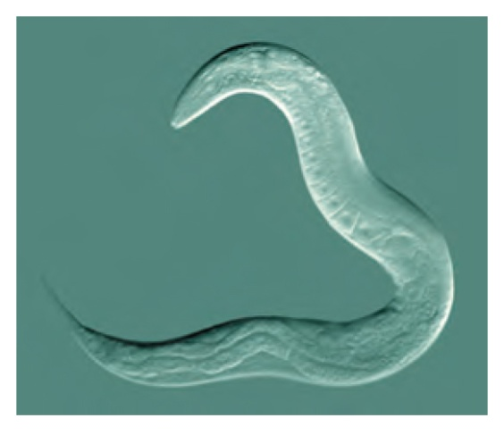
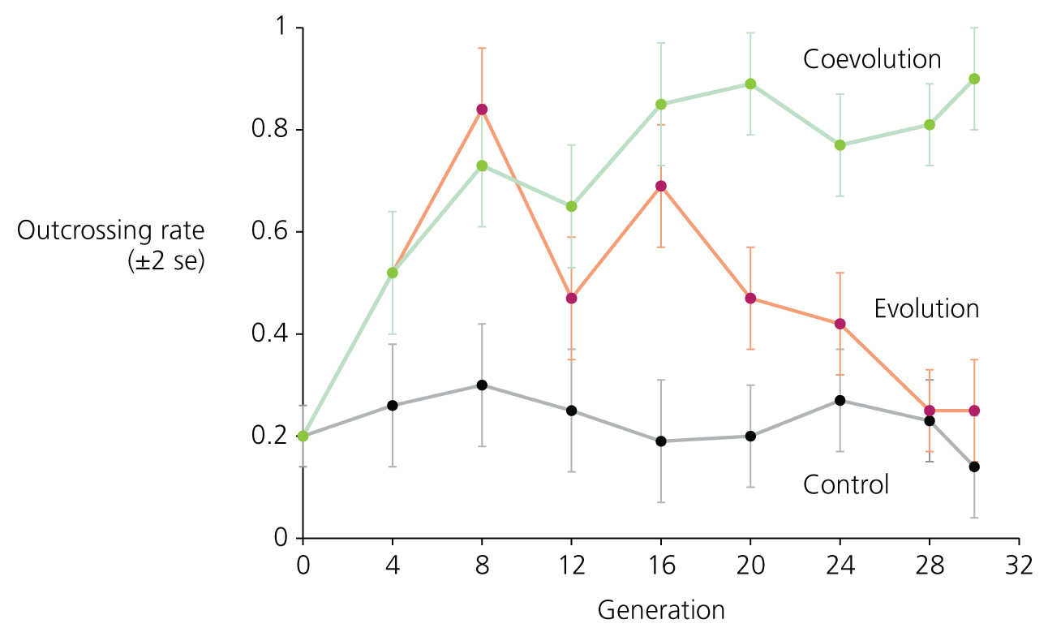
movement
Nematodes introduced to:
Medium with evolving pathogenic bacteria
Medium with non evolving pathogenic bacteria
Dead bacteria
Caenorhabdtis elegans
food
antibiotic
Notes:
First Rx with chemical mutagen to introduce genetic variation

Slide 23
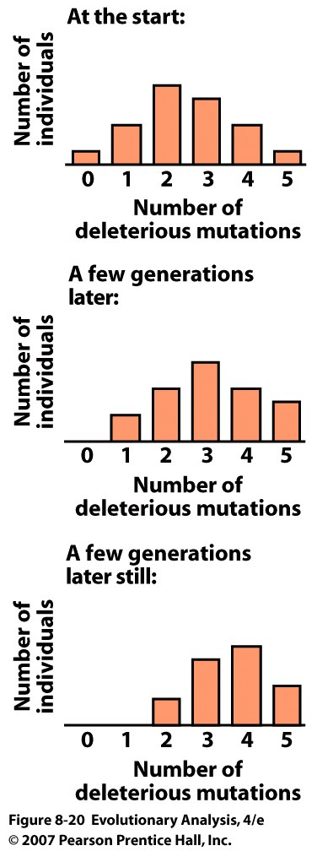
VI. Advantages of Sex
Drift & Disadvantageous alleles
Asexuality = Muller’s Ratchet
Sex = Loss of bad mutations
Notes:
Figure 8.20 Muller's ratchet: Asexual populations accumulate deleterious mutations
Each histogram shows a snapshot of a finite asexual population. In any given generation, the class with the fewest deleterious mutations may be lost by drift. Because forward-mutation to deleterious alleles is more likely than back-mutation to wild-type alleles, the distribution slides inexorably to the right. After Maynard Smith (1988).

Slide 24
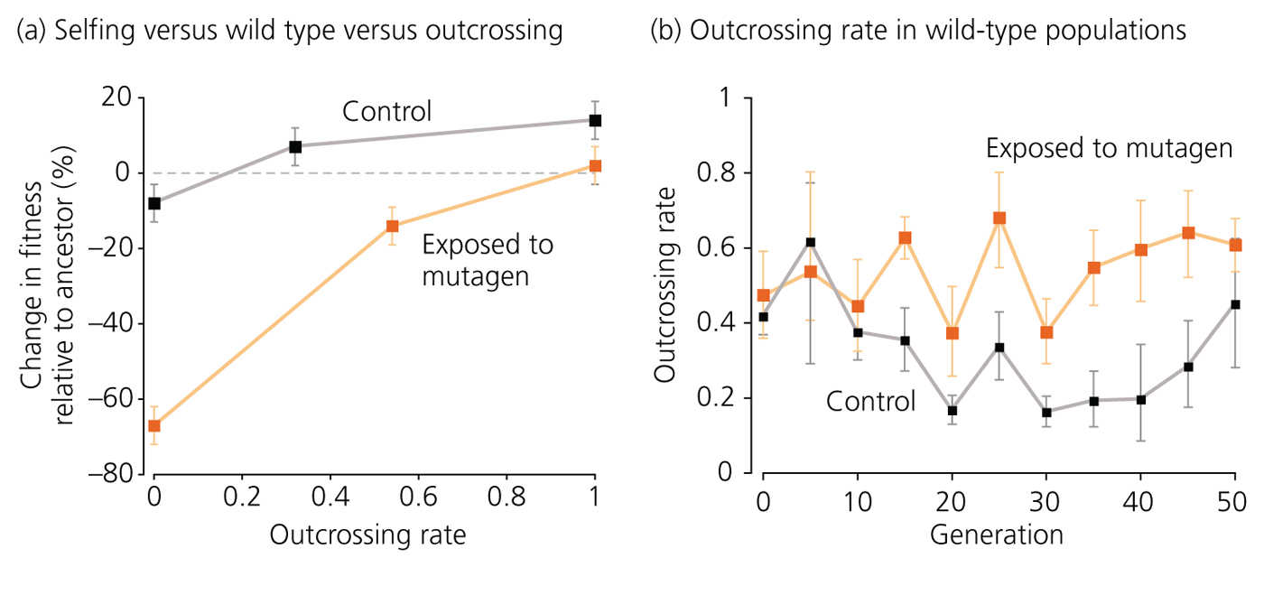
Recombination allows lineages to
get rid of bad mutations and to put
together good gene combinations
boulders
Caenorhabdtis elegans
Advantages of Sex Sex Evolves
Notes:
Mutation lethal to males, thus selfers
2 wild type, hermaphrodites and males
Hermaprodites unable to make sperm, thus obligate outcrossers

Slide 25
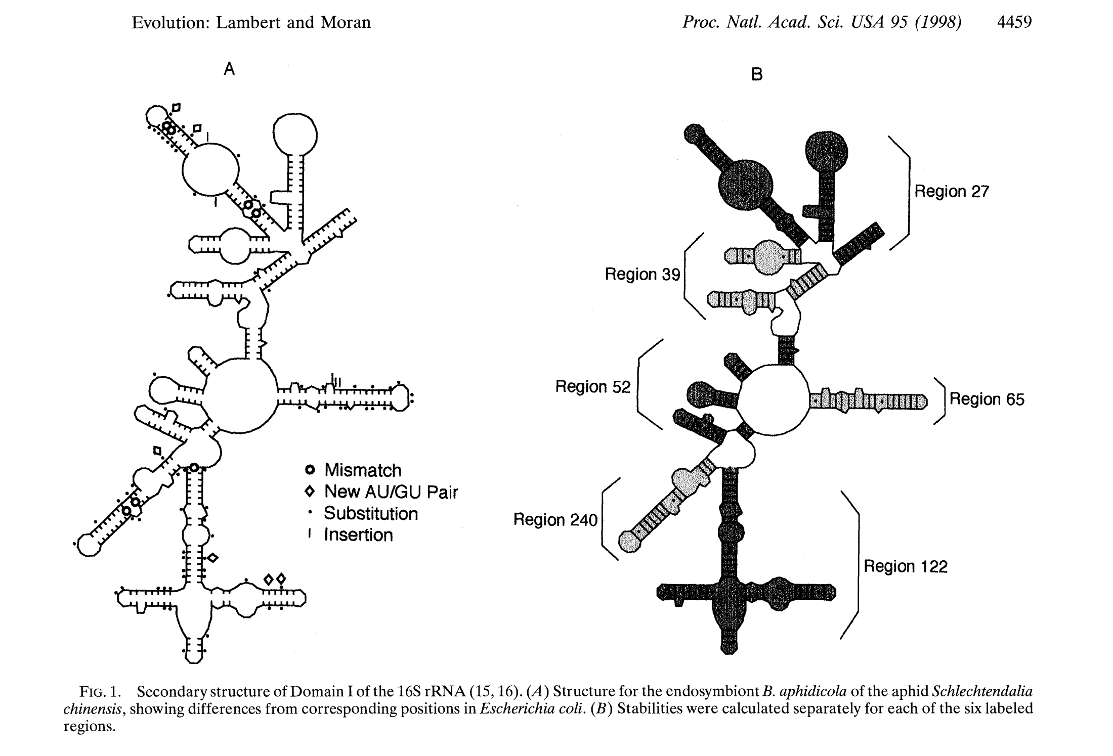
Thermal stability of small subunit rRNA:
Endosymbionts < Free living
Notes:
16S ribosomal RNA
From Wikipedia, the free encyclopedia
Jump to: navigation, search
Atomic structure of the 30S Subunit from Thermus thermophilus. Proteins are shown in blue and the single RNA strand in orange.^{[1]}
16S ribosomal RNA (or 16S rRNA) is a component of the 30S small subunit of prokaryotic ribosomes. It is approximately 1.5kb (or 1500 nucleotides) in length.^{[2]} The genes coding for it are referred to as 16S rDNA and are used in reconstructing phylogenies.
Multiple sequences of 16S rRNA can exist within a single bacterium.^{[3]}
Contents
1 Functions
2 Structure
3 Universal Primers
3.1 PCR applications
4 References
5 External links
Functions
It has several functions:
Like the large (23S) ribosomal RNA, it has a structural role, acting as a scaffold defining the positions of the ribosomal protein
The 3' end contains the anti-Shine-Dalgarno sequence, which binds upstream to the AUG start codon on the mRNA. The 3'-end of 16S RNA binds to the proteins S1 and S21 known to be involved in initiation of protein synthesis; RNA-protein cross-linking by A.P. Czernilofsky et al. (FEBS Lett. Vol 58, pp 281–284, 1975).
Interacts with 23S, aiding in the binding of the two ribosomal subunits (50S+30S)
Stabilizes correct codon-anticodon pairing in the A site, via a hydrogen bond formation between the N1 atom of Adenine (see image of Purine chemical structure) residues 1492 and 1493 and the 2'OH group of the mRNA backbone
Structure
Universal Primers

Slide 26
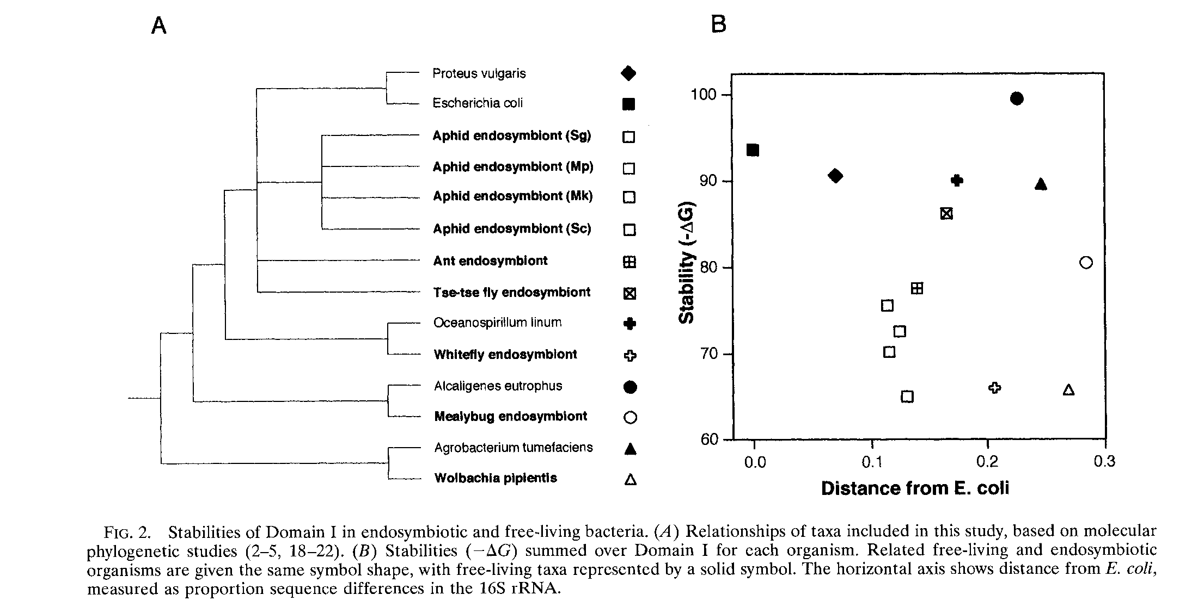
Notes:
But does bottleneck act quickly enough, more immediate advantage to sex?
Controls for sequence divergence due to neutral evolution
likely purifying selection maintaining

Slide 27
Conclusions
Both Sex and Asex are widespread
Must be advantages to both, depending on environment
Asex has 2 fold female fitness advantage, and no search cost or STD’s
Sex is advantageous because it eliminates bad mutations and brings together good mutations
Sex favors individuals in populations under selection. Sex increases response to selection

